Slide 1

Emotional Intelligence
Its your choice how you want to feel

Slide 2
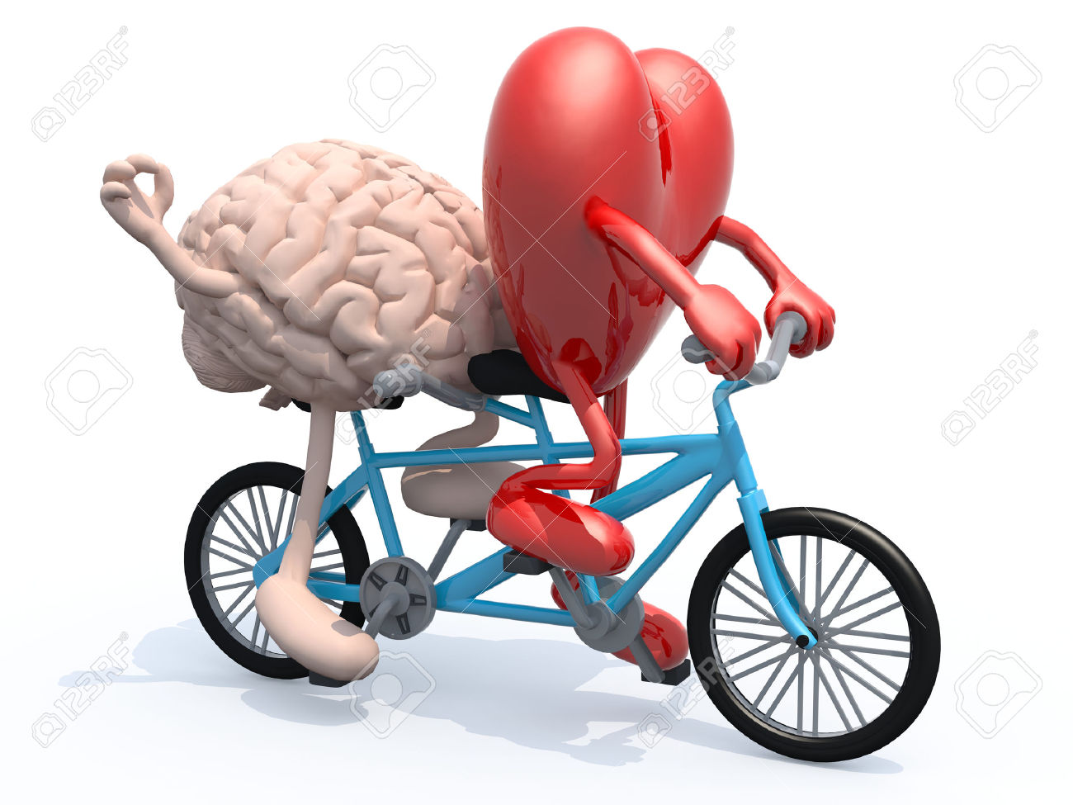
Emotional Intelligence
Emotions drive people, people drive performance

Slide 3




Slide 4




Slide 5

1. VIDEO

Slide 6
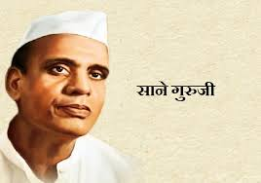

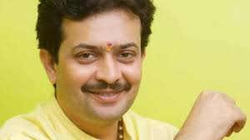
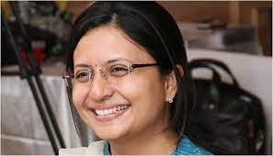
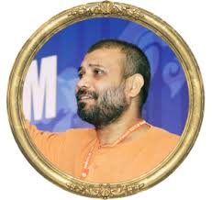

Sane Guruji
Sushant singh rajput
Bhayuji Maharaj
Sheetal Amate
swami vigyananand
Tunisha Sharma

Slide 7
CORPORATE EXAMPLES
OFFENSIVE LANGUAGE
AGGRESSIVE BEHAVIOUR
DELAY THE WORK
NOT TAKING INITIATIVE
NO CUSTOMER CENTRIC APPROACH
DONT CARE ABOUT CONSEQUENCES

Slide 8
3. What is Emotional intelligence?
Emotional intelligence (EQ) is the ability to recognize, regulate, and understand emotions—both in yourself and in others

Slide 9


Why EI is important aspect of life?

Slide 10
QUIZ

Slide 11
Q. What are the big 6 Emotions?
sadness, happiness, fear,
anger, surprise and disgust

Slide 12
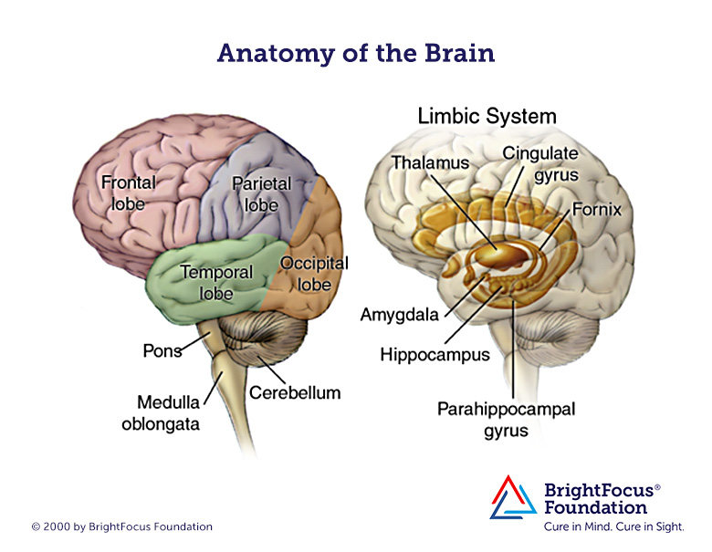
Q. What part of the brain understands emotions?
The limbic system

Slide 13
Q. What causes fear in the brain?
Amygdala

Slide 14
How do we process data in the brain?

Slide 15
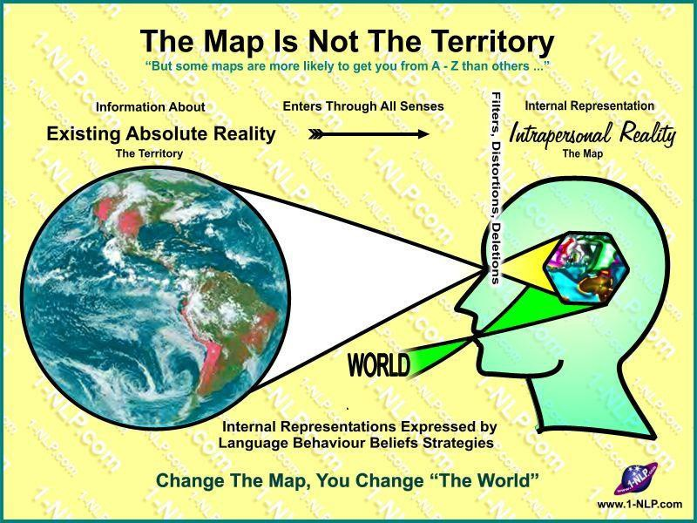
NLP -
Model of the World

Slide 16
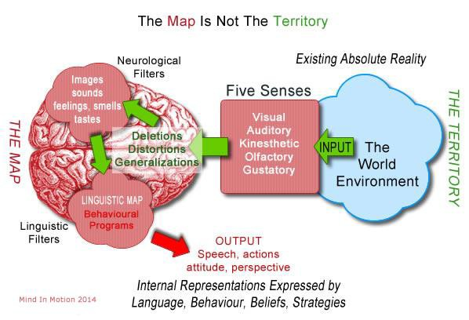
NLP -
Model of the World

Slide 17
Deletions
Distortions
Generalization

Slide 18
Deletion
Distortions
Generalization
The customer is very important to me and every word matters.
If I don’t get promotion, I am a failure.
My boss never understands my opinions
Namrata always comes late.

Slide 19
How do we react to different situations?

Slide 20


Slide 21
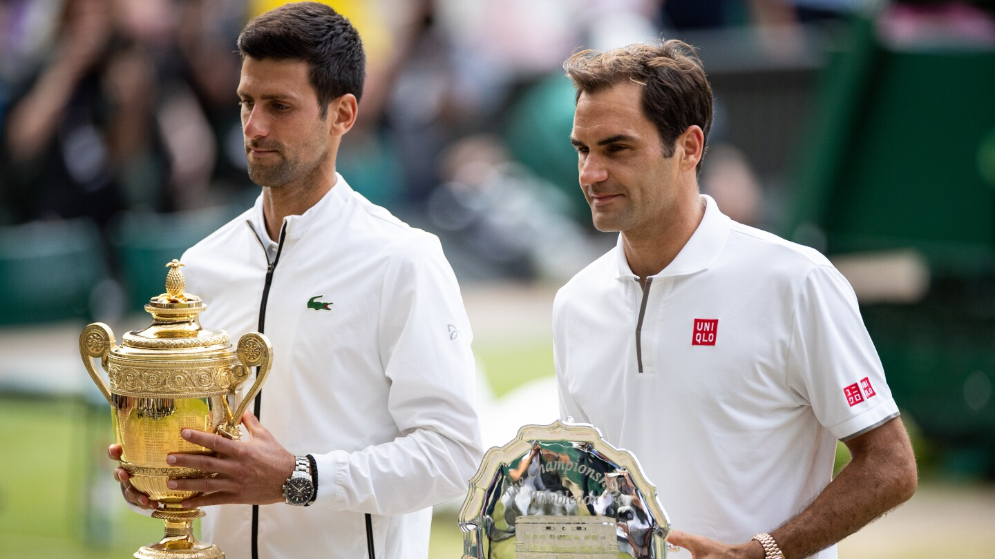

Slide 22
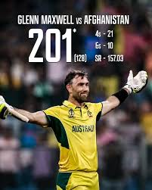

Slide 23
Components of EI
Self awareness
Self Regulation
Motivation
Empathy
Social skills

Slide 24
Self Awareness
Self Talk
SAVERS
Journaling
Seek feedback

Slide 25

Self talk is a continuous process
Self talk is a automatic mind process
Self talk improves self belief
Self talk improves self image

Slide 26



Slide 27


Slide 28

Write your small achievements
Life experiences
Write your routine
Write your goals
Write your dreams

Slide 29
Seek feedback about development
Seek feedback about improvements at work
Seed feedback about behavior
Seek feedback about KPI / KSA
Seek feedback

Slide 30
Self Regulation
PRT
Habits
Physical action

Slide 31


Slide 32

Make it obvious: Make the habit visible so it's easier to remember
Make it attractive: Make the habit appealing so it's easier to do
Make it easy: Make the habit simple so it's easier to perform
Make it satisfying: Make the habit rewarding so it's easier to continue

Slide 33
Motivation
Goal setting
Intrinsic vs extrinsic motivation
Self
development

Slide 34
The "2-Minute Rule" for Habit Formation
Set specific, challenging goals
Use the SMART framework to structure goals.
Focus on intrinsic motivation for long-term success
Long term vision
Goal setting

Slide 35


Slide 36
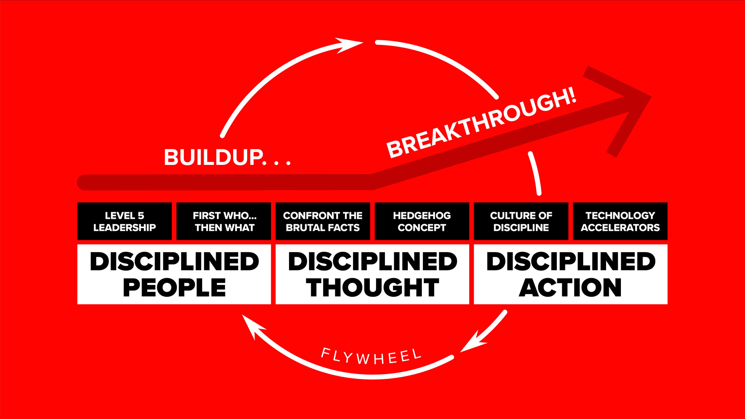
The Fly Wheel

Slide 37
100 SHARES
1993 – price 95, 100 * 95 = 9500
1994 – bonus 1:1 = quantity of shares 200
1997 - bonus 1:1 = quantity of shares 400
1999 - bonus 1:1 = quantity of shares 800
2000 – share split 2:1 = 1600 shares
2002- dividend 12.5 per equity = 12.5 * 1600 = 20000 rs
2004 - - bonus 3:1 = quantity of shares 6400
2004 – dividend 15 rs per equity - 15 * 6400 = 96000rs
2005 - dividend 6.5 rs per equity - 6.5 * 6400 = 41600rs
2006 - - bonus 1:1 = quantity of shares 6400 = 12800
2006 - dividend 30 rs per equity - 30 * 12800 = 384000rs

Slide 38
2007 - dividend 12.5 rs. per equity - 12.5 * 12800 = 160000 rs
2008 - dividend 37.25 rs. per equity - 37.25 * 12800 = 476800 rs
2009 - dividend 23.50 rs. per equity - 23.50 * 12800 = 300800 rs
2010 - dividend 55 rs. per equity - 55 * 12800 = 704000 rs
2011- dividend 35 rs. per equity - 35 * 12800 = 438000 rs
2012 - dividend 47 rs. per equity - 47 * 12800 = 601600 rs
2013 - dividend 47 rs. per equity - 47 * 12800 = 601600 rs
2014 - bonus 1:1 = quantity of shares 25600

Slide 39
2014 - dividend 73 rs. per equity - 73 * 25600 = 1868800 rs
2015 - bonus 1:1 = quantity of shares 51200
2015 - dividend 39.5 rs. per equity - 39.5 * 51200 = 2022400 rs
2016 - dividend 25.25 rs. per equity - 25.25 * 51200 = 1292000 rs
2017 - dividend 27.25 rs. per equity - 27.25 * 51200 = 1395000 rs
2018 - bonus 1:1 = quantity of shares 102400
2018 - dividend 37.5 rs. per equity - 37.5 * 102400 = 3840000 rs
2019 - dividend 22.50 rs. per equity - 22.50 * 102400 = 2304000 rs

Slide 40
2020 - dividend 21.50 rs. per equity - 21.50 * 102400 = 2201600 rs
2021 - dividend 15 rs. per equity - 15 * 102400 = 1536000 rs
TOTAL DIVIDENT - 2002 -2021
20474200
TOTAL VALUE OF ALL STOCKS
102400 * 1711.45
17,52,52480

Slide 41
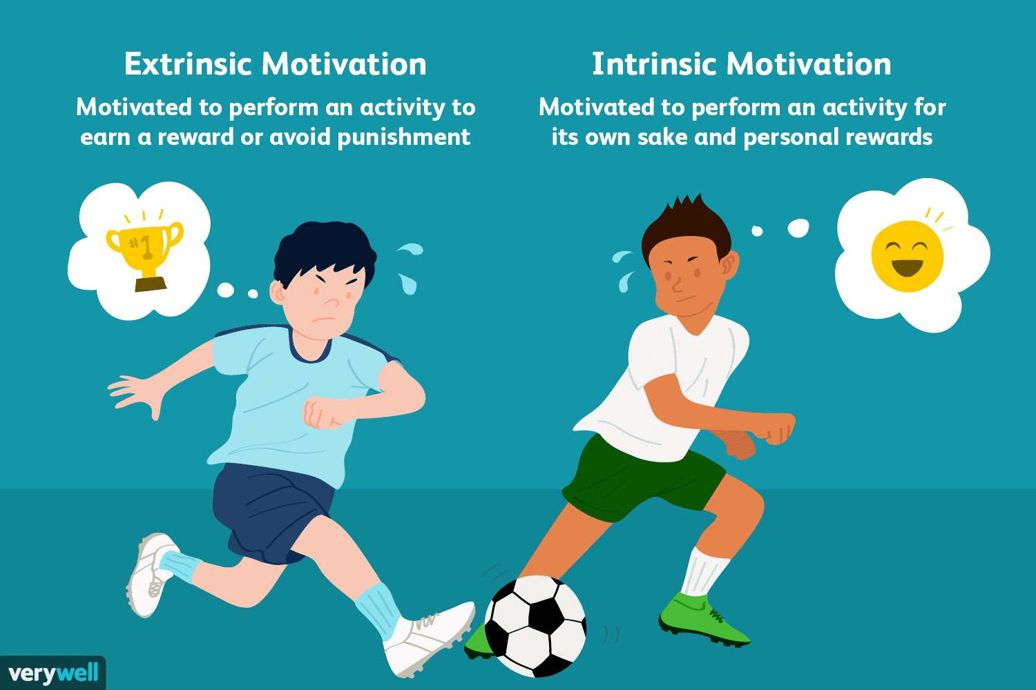
Intrinsic vs extrinsic motivation

Slide 42

Self
development

Slide 43
Empathy
Active listening
Putting yourself in someone's shoes

Slide 44
Social skills
Team building
Self leadership

Slide 45
ACTION PLAN
WHAT ARE THE 3 ACTIONS YOU WILL TAKE FOR YOURSELF?
WHAT ARE THE 3 STEPS YOU WILL INITIATE IN THE TEAM?

